Slide 1
Comp 313
Design and Analysis of Algorithms
Lecture 4 SORTING

Slide 2
Devotional Meditation
Ephesian 6:24
Grace to all who love our Lord Jesus Christ with an undying love.

Slide 3
Lecture Outline
Introduction
Sorting Techniques
Sorting Analysis
Reading materials

Slide 4
What is sorting?
Sorting refers to arranging data in a particular format. Sorting algorithm specifies the way to arrange data in a particular order. Most common orders are in numerical .
Sorting optimizes searching
Example
Phone directory
Dictionary
.

Slide 5
In-place Sorting VS Not-in-place Sorting
Sorting algorithms that do not requires extra space for comparison are known as in place sorting while Sorting algorithms that requires extra space for comparison are known as in out of place sorting.

Slide 6
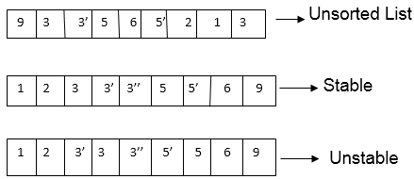
Stable vs Unstable sorting
Stable Sorting
A sorting algorithm is said to be stable if two objects with equal keys appear in the same order in sorted output as they appear in the input unsorted array.
Unstable
A sorting algorithm is said to be unstable if two objects with equal keys appear in different order in a sorted output compared the input of the unsorted array.

Slide 7
Adaptive VS Non-Adaptive Sorting Algorithm
A sorting algorithm is said to be adaptive, if it takes advantage of already 'sorted' elements in the list that is to be sorted. That is, while sorting if the source list has some element already sorted, adaptive algorithms will take this into account and will try not to re-order them.
A non-adaptive algorithm is one which does not take into account the elements which are already sorted. They try to force every single element to be re-ordered to confirm their sortedness.

Slide 8
Sorting Algorithms
Quick sort
Bubble sort
Selection sort
Insertion sort
Merge sort
Shell sort
Radix sort
Heap sort
Bucket sort

Slide 9
Quick sort
It is an algorithm that uses Divide & Conquer
Divide: Rearrange the elements and split arrays into two sub-arrays and an element in between search that each element in left sub array is less than or equal to the pivot element and each element in the right sub- array is larger than or the pivot element.
Conquer: Recursively, sort two sub arrays.
Combine: Combine the already sorted array.
Left <=P<=Right
The complexity of quick sort in the average case is O(n log n) and in the worst case is O(n²).
QUICKSORT (array A, int m, int n)
if (n > m)
then
i ← a random index from [m,n]
swap A [i] with A[m]
p ← PARTITION (A, m, n)
QUICKSORT (A, m, p - 1)
QUICKSORT (A, p + 1, n)

Slide 10
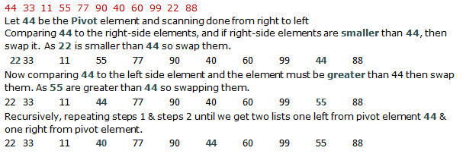
Example

Slide 11
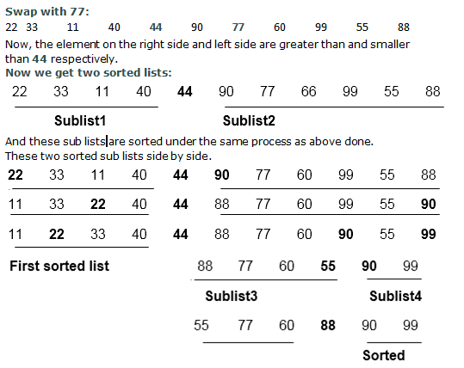
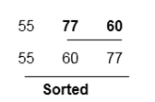


Slide 12
Bubble Sort
Bubble Sort also known as Exchange Sort, is a simple sorting algorithm. It works by repeatedly stepping throughout the list to be sorted, comparing two items at a time and swapping them if they are in the wrong order.
BUBBLE SORT (A)
for i ← 1 to length [A]
for k ← length [A] down to i+1
if A[k] <A[k-1]
swap (A[k], A [k-1])

Slide 13
Bubble sort Analysis
Input: n elements are given.
Output: the number of comparisons required to make sorting.
Logic: If we have n elements in bubble sort, then n-1 passes (iterations) are required to find a sorted array.
In pass 1: n-1 comparisons are required
In pass 2: n-2 comparisons are required
In pass 3: n-3 comparisons are required
............................................................................
...............................................................................
In pass n-1: 1 comparisons is required
Total comparisons: T (n) = (n-1) + (n-2) +...........+ 1
=
= o (n²)
Therefore complexity is of order n²

Slide 14
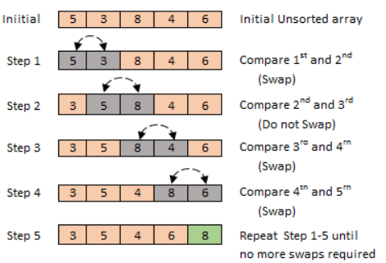
Example of Bubble sort

Slide 15
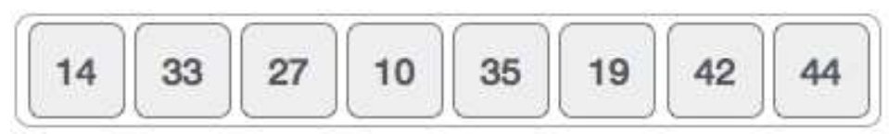
Selection sort
The smallest element is selected from the unsorted array and swapped with the leftmost element, and that element becomes a part of the sorted array. This process continues moving unsorted array boundary by one element to the right. This algorithm is not suitable for large data sets as its average and worst case complexities are of O(n2), where n is the number of items.
ALGORITHM: SELECTION SORT (A)
1. k ← length [A]
2. for j ←1 to n-1
3. smallest ← j
4. for I ← j + 1 to k
5. if A [i] = A [ smallest]
6. then smallest ← i
7. exchange (A [0], A [smallest])

Slide 16
Selection sort analysis
:
Input: n elements are given.
Output: the number of comparisons required to make sorting.
Logic: If we have n elements in selection sort, then n-1 passes are required to find a sorted array.
In pass 1: n-1 comparisons are required
In pass 2: n-2 comparisons are required
In pass 3: n-3 comparisons are required
............................................................................
...............................................................................
In pass n-1: 1 comparison is required
Total comparisons: T (n) = (n-1) + (n-2) + (n-3) +........+ 1
=
= o (n²)
Therefore complexity is of order n²

Slide 17
Insertion sort
This is an in-place comparison-based sorting algorithm. Here, a sub-list is maintained which is always sorted. For example, the lower part of an array is maintained to be sorted. An element which is to be 'inserted’ in this sorted sub-list, has to find its appropriate place and then it has to be inserted there .
This algorithm is not suitable for large data sets as its average and worst case complexity are of Ο(n2), where n is the number of items.
ALGORITHM: INSERTION SORT (A)
1. For k ← 2 to length [A]
2. Do key ← A[k]
3. i=k-1
4. while i>0 and A[i]>key
5. do A[i+1] ← A[i]
6. i=i-1
7. A[i+1] ← key

Slide 18
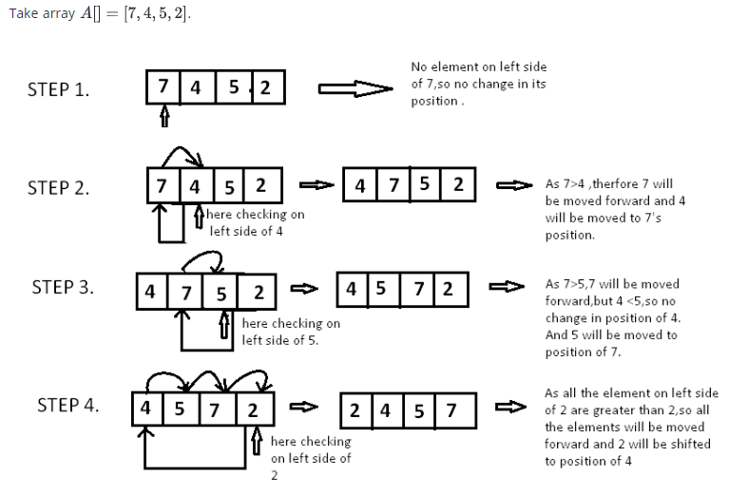

Slide 19
Merge Sort
It closely follows the divide & Conquers paradigm.Conceptually, it works as follows:
Divide: Divide the unsorted list into two sublists of about half the size.
Conquer: Sort each of the two sublists recursively until we have list sizes of length 1, in which case the list items are returned.
Combine: Join the two sorted Sub lists back into one sorted list.
time complexity being Ο(n log n),
ALGORITHM-MERGE SORT
1. If p<r
2. Then q ← ( p+ r)/2
3. MERGE-SORT (A, p, q)
4. MERGE-SORT ( A, q+1,r)
5. MERGE ( A, p, q ,r)

Slide 20
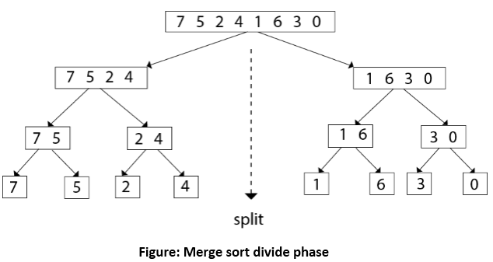
Divide phase

Slide 21
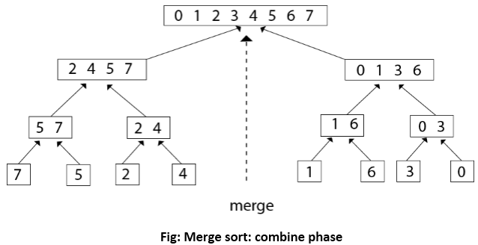
Merge phase

Slide 22
Reading assignment
Heap sort
Shell sort
Radix sort
Bucket sort

Slide 23
REFERENCE MATERIALS
The design and Analysis of Computer Algorithms by AHO/Hocroft Ullman
Design and analysis of Algorithms by Russell L Shackelford
Introduction to the Design and Analysis of Algorithms by R.C.T Lee, S.S Tseng Chang Y.T Tsai
Judith L GerstingMathematical Structures for computer science 4th edition

